Slide 1

Project Title
Team Id: CS_2B_14
Ashish Kumar Verma (2101640100072)
Bishwajeet Singh (2101640100094)
Devansh Sharma (2101640100099)

Slide 2
Project Objective
Our Project is windows based application used for educational purpose. which has a only one goal to strengthen relationships with people and make education easier
To enable the deaf and dumb to communicate and contribute to the growth of an organization through synthesized voice.
To enable the blind and elderly people enjoy a User-friendly computer interface.
To prevent eye strain, and user can sit and listen comfortably
To help in improving spelling, reading, writing skills.
Team_Id: CS_2B_14
2

Slide 3
Feasibility Study
Technical Feasibility :- This software only requires the use of python which is already widespread and used. Youtube which is used by billions of users has some parts of it implemented using python. So the only technology required in this project is already available and familiar. Hence, this software is technologically feasible
Team_Id: CS_2B_14
3

Slide 4
Operational Feasibility :- The software would be very easy to use and is designed only to help the people especially, the ones who cannot speak and also those who are visually challenged. This software would be a great help to them to live a normal life.
Legal Feasibility :- Legal Feasibility is a measure of how well a solution can be implemented within existing legal policy. Our project is not violets any legal policy and it have no any copyrights issues . We have to make sure that we use the license software
Team_Id: CS_2B_14
4

Slide 5
Economic Feasibility :-Economic justification includes abroad range of concerns that includes cost benefit analysis. This system will be developed and operated in the existing hardware and software infrastructure. Hence there is no need of procuring additional hardware and software for the proposed system. The proposed will give the information within minutes, hence the performance is improved. This system uses only the Open source which is economically feasible. The proposed system will minimize the time and efforts involved in processing, hence it is economically feasible
Team_Id: CS_2B_14

Slide 6
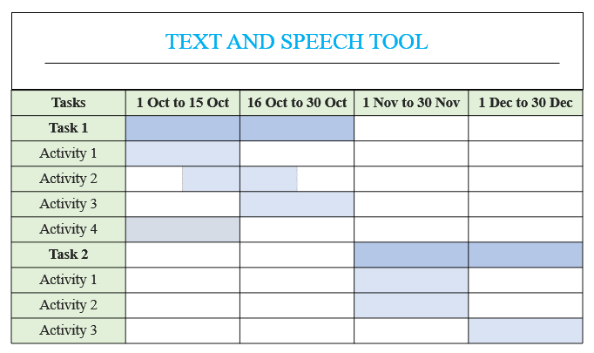
Schedule Feasibility:-
Task 1 :- Task 2 :-
Activity 1 :- Text to Speech (GUI + Function) Activity 1 :- Speech to Text (Function)
Activity 2 :- Speech to Text (GUI) Activity 2 :- Translator (Function)
Activity 3:- Translator (GUI) Activity 3 :- Dictionary (Function)
Activity 4:- Dictionary (GUI)
Team_Id: CS_2B_14

Slide 7
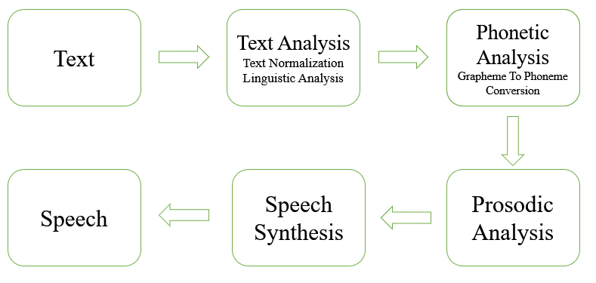
Methodology
Our project is combination of four packages which are text to speech, speech to text, translator and dictionary.
Steps for text to speech:-
1- Import libraries (gtts,tkinter,playsond)
2- Initializing window Using tkinter module
3- Create function to convert text to speech
Architecture diagram
Team_Id: CS_2B_14

Slide 8
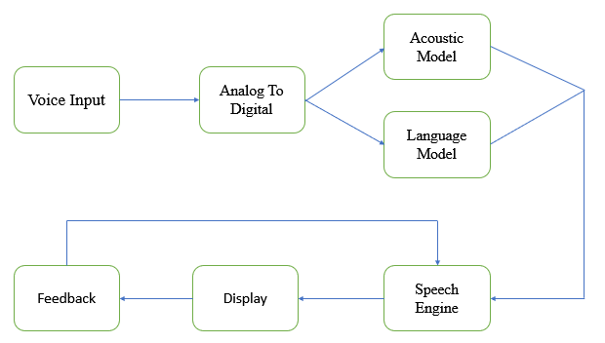
Steps for speech to text :-
1- Import libraries (speech_recoginition)
2- Initializing window using tkinter module
3- Create backend function for speak and record function
Architecture diagram
Team_Id: CS_2B_14

Slide 9
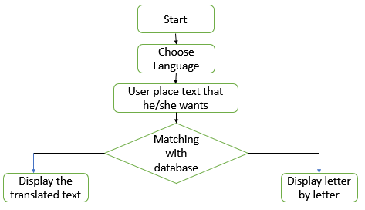
Steps for translator :-
1- Import module (googletrans)
2- Adding language to the project
3- Creating window using tkinter module
4- Create backend translate function
Flow Chart
Team_Id: CS_2B_14

Slide 10
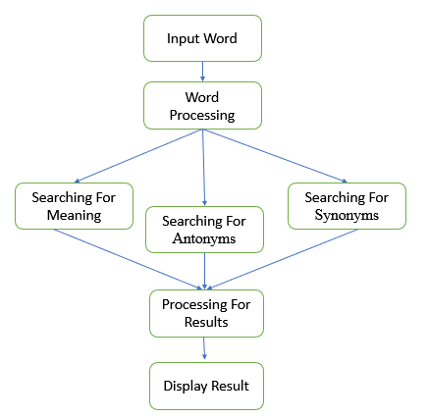
Steps for dictionary :-
1- Import module (pydictionary)
2- Create window using tkinter module
3- Create backend function for dictionary
Flow Chart
Team_Id: CS_2B_14
10

Slide 11
Tools/Technology Used
Hardware Requirements
• Processor i3
• RAM-2gb
• Hard Disk Space 5gb
Software Requirements
• Python 3.10
• Visual Studio Code
• Windows 7/8/10/11
Team_Id: CS_2B_14

Slide 12
Role of Team Member
Ashish Kumar Verma :-
1. Text To Speech
> Text to speech converting function
> GUI using tkinter
2. Speech To Text
> Speech to text converting function
> GUI using tkinter
Bishwajeet Singh :-
1. Translator
> Translate function Which Convert The Sentences from one language to other language
> GUI using tkinter
Devansh Sharma :-
1.Dictionary
> Dictionary function which gives the meaning of the words
> GUI using tkinter
Team_Id: 22_CS_2B-05

Slide 13
References
https://www.geeksforgeeks.org/convert-text-speech-python/
https://www.geeksforgeeks.org/convert-text-speech-python/
https://www.geeksforgeeks.org/convert-text-speech-python/
https://data-flair.training/blogs/python-speech-to-text-and-text-to-speech/
https://techvidvan.com/tutorials/python-language-translator/ https://www.codewithharry.com/videos/python-gui-tkinter-hindi-0/
Team_Id: 22_CS_2B-05

